Slide 1
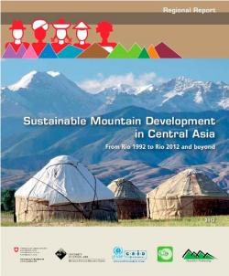

Rio+20 and mountains
2 years later..
Mr. Matthias Jurek
UNEP Vienna Liaison Office–
Secretariat of the Carpathian Convention

Slide 2

Paras 210-212
Mountains
210. We recognize that the benefits derived from mountain regions are essential for sustainable development. Mountain ecosystems play a crucial role in providing water resources to a large portion of the world’s population; fragile mountain ecosystems are particularly vulnerable to the adverse impacts of climate change, deforestation and forest degradation, land use change, land degradation and natural disasters; and mountain glaciers around the world are retreating and getting thinner, with increasing impacts on the environment and human well-being.
211. We further recognize that mountains are often home to communities, including indigenous peoples and local communities, that have developed sustainable uses of mountain resources. These communities are, however, often marginalized, and we therefore stress that continued effort will be required to address poverty, food security and nutrition, social exclusion and environmental degradation in these areas. We invite States to strengthen cooperative action with effective involvement and sharing of experience of all relevant stakeholders, by strengthening existing arrangements, agreements and centres of excellence for sustainable mountain development, as well as exploring new arrangements and agreements, as appropriate.
212. We call for greater efforts towards the conservation of mountain ecosystems, including their biodiversity. We encourage States to adopt a long-term vision and holistic approaches, including by incorporating mountain-specific policies into national sustainable development strategies, which could include, inter alia, poverty reduction plans and programmes for mountain areas, particularly in developing countries. In this regard, we call for international support for sustainable mountain
development in developing countries.

Slide 3
Follow-up action by UNEP
Inter-regional project “Climate change action in developing countries with fragile mountainous ecosystems from a sub-regional perspective”, PoW 2014-15/16-17, sp: climate change
Support climate change adaptation and cooperative action, strengthen RMCCA as centre of excellence
ICSD Decision: April 2014
Mountain Workshop, 24 November 2014 – towards participatory sub-regional mountain response assessments

Slide 4
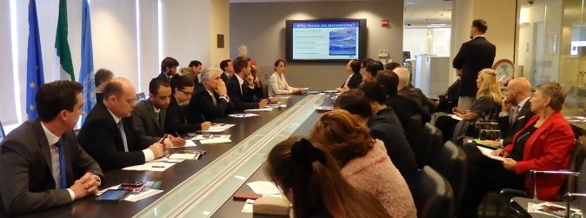

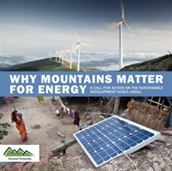
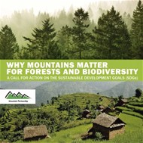
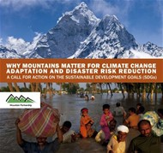

Follow-up action by UNEP
Overall initiative in the context of Mountain Partnership to mainstream mountain-related issues into the Post-2015/SDGs discussions
Mountain policy briefs (visit also www.grida.no)

Slide 5
OWG proposal June 2014
Goal 6 water
6.6 By 2020, protect and restore water-related ecosystems, including mountains, forests, wetlands, rivers, aquifers and lakes
Goal 15 biodiversity
15.1 By 2020, ensure the conservation, restoration and sustainable use of terrestrial and inland freshwater ecosystems and their services, in particular forests, wetlands, mountains and drylands, in line with obligations under international agreements
Future: Implementation of mountain-specific targets and indicators in Central Asia?

