Slide 1

Sustainable management of biodiversity :
a building block for Green Economy
Thierry Lucas, UNEP
Notes:
Exchange of opinions on current initiatives, priority areas with the focus on addressing environmental issues: degradation of mountain ecosystems , degradation of land, atmospheric air pollution, wastes management, water pollution…

Slide 2
Why is biodiversity important
for ensuring a sustainable future?
Natural resources essential for human development: food, fibre, fuel, medicinal plants
Functioning of ecosystems providing essential ecosystem services
Ecosystems and species and genetic diversity basis for our food systems
Spiritual, psychological and cultural benefits
Notes:
Q1: Why is biodiversity important for sustainable development?
Biodiversity is important for sustainable development in many ways, as it provides the critical foundation for sustainable development and human well-being: (i) At the simplest level, the components of biodiversity comprise many natural resources essential for human development including food, fibre, fuel, and medicinal plants. These are provided both from managed agricultural ecosystems and less managed “natural” ecosystems. (ii) Biodiversity also underpins the functioning of these ecosystems and the provision of ecosystem services such as clean water (quality, quantity and evenness of supply), as well as services such as pollination, regulation of pests and diseases, etc. (iii) Ecosystems, species and genetic diversity provide for adaptation to current needs and adaptability to meet future needs. Ecosystem resilience depends on biodiversity. (iv) Biodiversity also provides spiritual, psychological and cultural benefits.

Slide 3
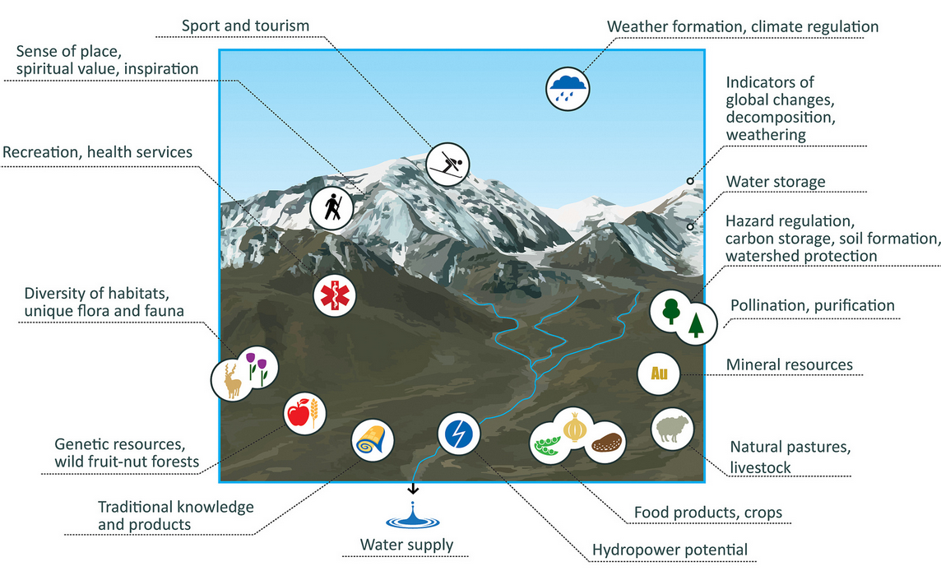
Ecosystem Goods and Services in CA mountains
Notes:
Here are listed all services provided by a mountain ecosystem in Central asia
Go through each service to show the variety of what a mountain can offer – we usually have a tendency to forget essential services such as weather formation, pollination, …

Slide 4
Biodiversity and sustainable development
  Biodiversity and the economic pillar
  Ecosystem Services = foundation for any economic activity – raw materials come from nature
  Environmental damages (floods, fires) have negative economic impacts
  Biodiversity and the social pillar
  The poor are highly dependent on biodiversity (1.6 bn people depend on forests for food, medicine and fuel)
  Direct impacts (health – air pollution, mercury) and indirect impacts (nutrient intake reduced due to soil erosion, bad pollination)
Notes:
Environment and the economic pillar
Environmental services and economic goods can be interchanged to a certain degree, which can justify limited
environmental losses in exchange for economic growth. But it is important to remember that these substitutions
have their limits; neither aspect should outweigh the other. Environmental services are not less valuable
than economic goods. Breathing clean air, finding firewood for cooking, drinking clean water and being safe from
floods… all provide for essential human needs. So, despite the fact that the environment has suffered from unbalanced
economic growth, the economic and environmental pillars play a complementary role in satisfying human
needs. They are also interrelated. For instance, economic development can reduce our direct dependence on
nature, and yet depends on the environment in several ways:
* Raw materials used in the production of goods come from nature, as does the energy needed for production
and transport.
* The cost of extracting raw materials tends to increase when natural resources become scarce or
degraded.
* Environmental services have a crucial importance but are not included in national accounts because they
are difficult to value in monetary terms.
* Adverse environmental effects (e.g. pollution, floods or fires) can damage or destroy economic goods and
equipment.
* Labour productivity is linked to the nutrition and health of workers, two variables which are directly influenced
by the environment.
* Sound environmental management and mainstreaming can reduce costs, through increased efficiency or
through prevention, with an important potential for further development in this field.
* A high-quality environment is an important asset for tourism (as shown e.g. by the growth in ecotourism);
it is also the basis for some indigenous peoples’ livelihoods, and for an important share of pharmaceutical
production.

Slide 5
Threats to Ecosystems and Biodiversity in Central Asia
Central Asia home to wide variety of landscapes
Ecosystems such as water, forest, pastures highly vulnerable to both human and natural influences
e.g. unsustainable forest use, degradation of mountain ecosystems → negative impact on river hydrology, water quality
Amu Darya: industrial and agricultural pollution → quality of drinking water
Need: environmental concerns reflected in development and economic frameworks and policies

Slide 6
Projects in Central Asia
“Support for the revision of NBSAPs in Central Asian countries” (Kazakhstan, Kyrgyzstan, Tajikistan, Turkmenistan and Uzbekistan)
“Strengthening MEA synergies and indicators
in NBSAPs for the Pan-European region (Eastern Europe, Southern Caucasus, and Central Asia)
Partners: UNEP-WCMC, TEEB, WWF, UNDP (implementing agency supporting the NBSAP revision process in Kazakhstan, Uzbekistan and Turkmenistan, while Kyrgyzstan and Tajikistan, are led by UNEP), etc.
Notes:
Outcomes:
Increased capacity to revise NBSAPs through transboundary learning and collaboration
Indicators to monitor the progress in implementing NBSAPs
Thorough understanding of the role of ecosystems and their services in poverty alleviation and development
Increased capacity to integrate TEEB-related activities into NBSAPs in order to support the integration of biodiversity and ecosystem services concerns into economic and development frameworks and policies
Next steps:
“Synergetic implementation of National Biodiversity Strategies and Action Plans in Central Asia”
Identification of projects to implement revised NBSAPs
Activities to be undertaken by implementing agencies
Roadmap to implement activities (project outline, timeline and budget allocation)
Grant application for each country in Central Asia. Depending on each case, these could be fully developed grant project proposals

Slide 7
Threats to Ecosystems and Biodiversity in Central Asia
Central Asia home to wide variety of landscapes
Ecosystems such as water, forest, pastures highly vulnerable to both human and natural influences
e.g. unsustainable forest use, degradation of mountain ecosystems → negative impact on river hydrology, water quality
Amu Darya: industrial and agricultural pollution → quality of drinking water
Need: environmental concerns reflected in development and economic frameworks and policies

Slide 8
Way Forward
Reverse biodiversity decline and restore key ecosystems
Mainstream biodiversity into key sectors (agriculture, fisheries, forestry)
Biodiversity and ecosystems : key factors to ensure achieving SDGs and for building a green economy

